Slide 1
Gases & Stoichiometry
Chapter 12

Slide 2
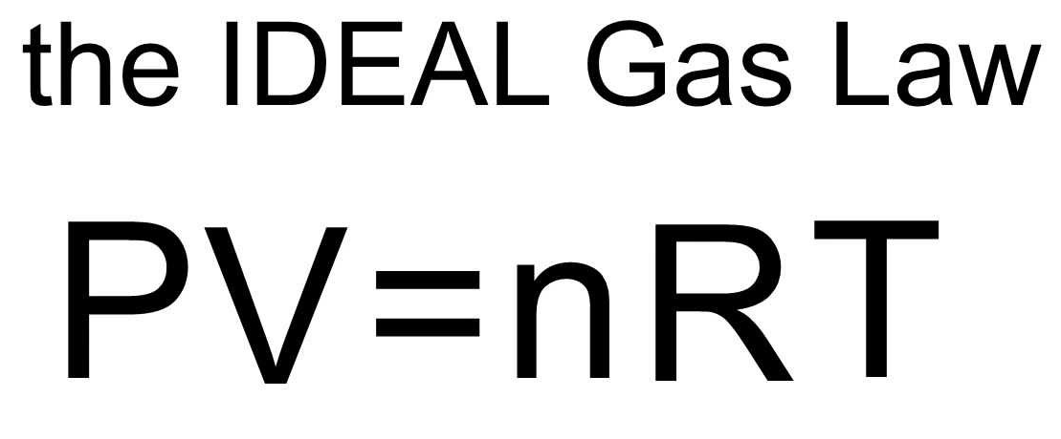
Recall, that if we combine Avogadro's theory with the combined gas law, we can create…

Slide 3
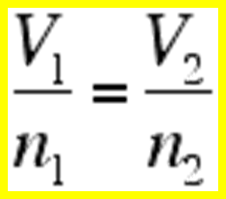
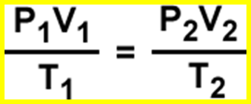
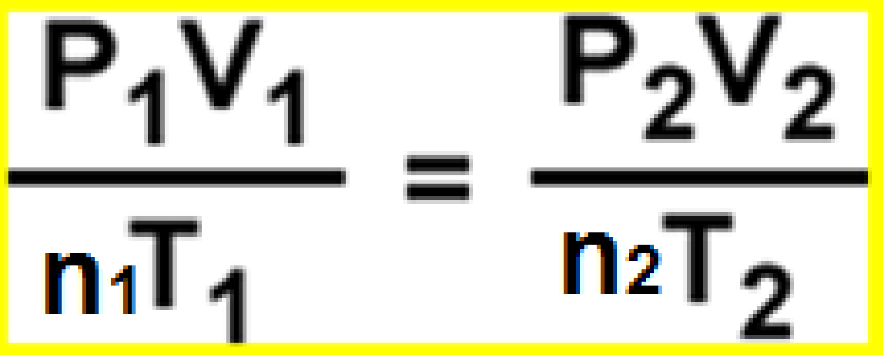
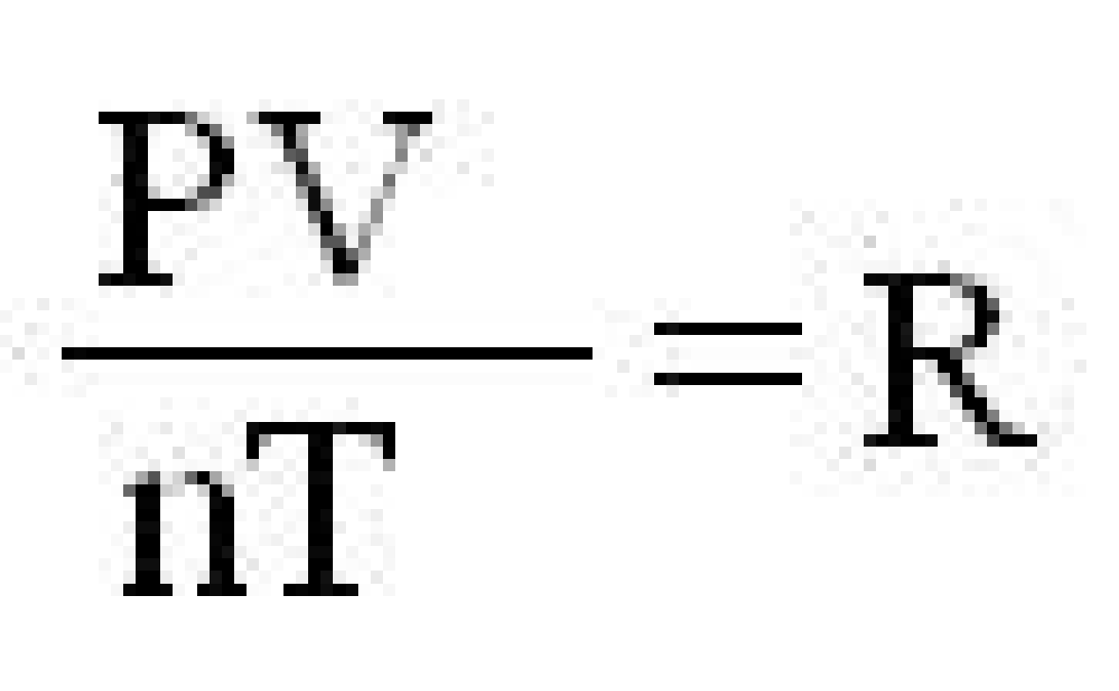
Ideal Gas Law
How did we get there??
Recall: (for constant T & P)
And (for a fixed amount of gas)
Therefore
This means
Where: R = Universal Gas Law Constant

Slide 4

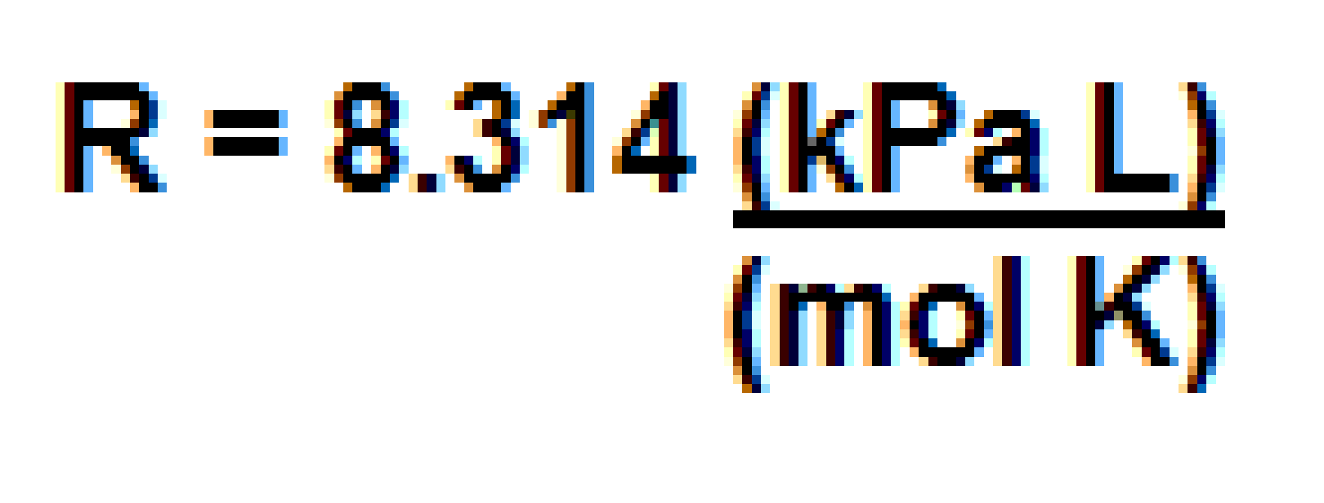
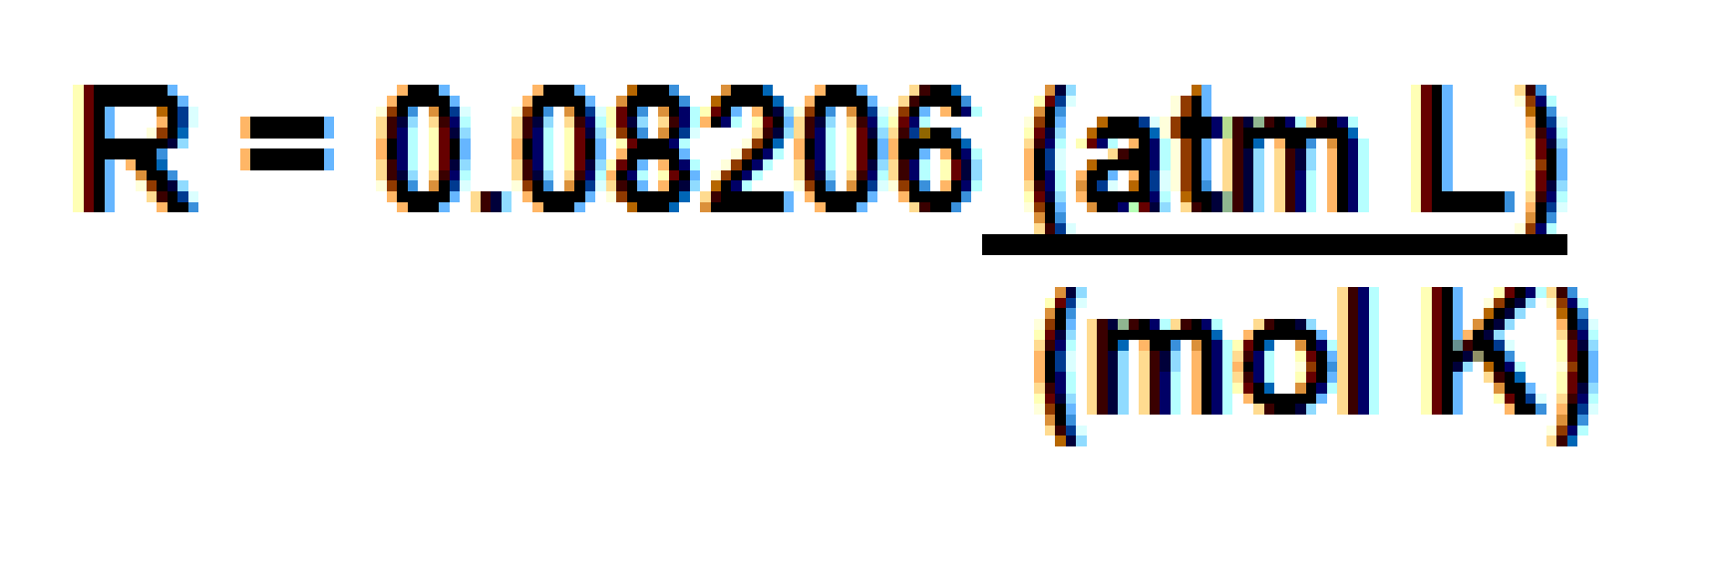
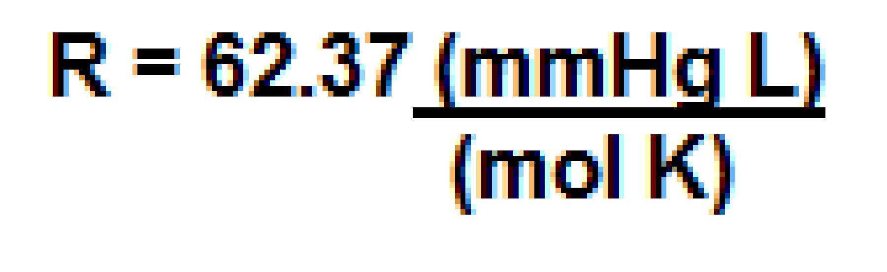

Ideal Gas Law
The value of R can be calculated using one mole of a gas at STP:
P = 101.3 kPa
V = 22.4 L
T = 273 K
n = 1.00 mol
R can also be expressed in other units:
The Ideal Gas Law Equation can be rearranged as:

Slide 5
Ideal Gas Law
Sample Problems:
The pressure gauge on a 15.0 L cylinder of oxygen gas has a reading of 2.70 x 10³ kPa and a temperature of 22.5 ºC. What is the mass of oxygen in the cylinder?
What volume of carbon dioxide did a swimmer breathe out when he exhaled 10.5 g of CO₂ @ SATP into a flask to measure his lung capacity?
HW:
-p.487 # 12-14
-p.488 #1-5

Slide 6
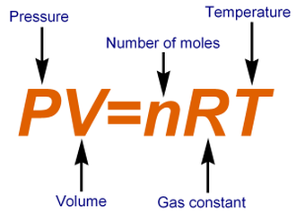

Slide 7
Real Gas Behaviour (p.483)
There are several assumptions in KMT that allow us to imagine all gases behaving in an “ideal” way. ie. All gas molecules are the same.
Gas molecules have zero volume
Forces of attraction are zero
Molecules move in straight lines
Collisions are completely elastic
At high pressures and low temperatures, there are problems with the assumptions:
In very small volumes there will be many more interactions and collisions
The volume of the gas molecules is now a significant fraction of the container

Slide 8
The Mole and Gases
Many chemical reactions involve gases as reactants or products
Measured at the same temperature and pressure, gases react or are chemically produced in simple whole number volume ratios. (Gay-Lussac’s Law of Combining Gas Volumes)
Coefficients for gaseous substances in a balanced equation represent volume ratios as well as mole ratios, if temperature and pressure conditions are the same. (Avogadro’s Hypothesis)
H₂ _{(g)} + Cl₂ _{(g)} → 2 HCl _{(g)}
3 H₂ _{(g)} + N₂ _{(g)} → 2 NH₃ _{(g)}
1 mol
1 mol
2 mol
1 L
1 L
2 L
3 mol 1 mol 2 mol
3 L 1 L 2 L

Slide 9
12.3 Gas Law Stoichiometry
A balanced chemical equation can be used to solve problems for gases.
Sample Problems:
3 H₂ _{(g)} + N₂ _{(g)} → 2 NH₃ _{(g)}
Suppose that in a reaction, 5.0 L of nitrogen reacts with hydrogen gas at the same T & P:
What volume of ammonia is produced?
What volume of hydrogen is consumed?
Zinc reacts with sulfuric acid to produce 380 mL of hydrogen gas measured at 101.6 kPa and 25ºC. What mass of zinc is consumed in this reaction?
Acetylene gas, C₂H₂, is normally prepared in the laboratory by reacting calcium carbide CaC₂, with water.
CaC₂ _{(s)} + 2 H₂O _{(l)} → C₂H₂ _{(g)} + Ca(OH)₂ _{(aq)}
What mass of calcium carbide is required to produce 235 mL of acetylene gas at SATP?

